Slide 1
Large-Scale Assessment Methodology: Psychometric and Statistical Models
Ting Zhang, Ph.D.
Senior Researcher
EdSurvey Large-Scale Data Analysis Training Series| Oct 2021

Slide 2
Overview
Why plausible values?
How to use plausible values in a large-scale data analysis?

Slide 3

What are Plausible Values?
Proficiency estimates for an individual student, drawn at random from a conditional distribution of potential scale scores.
All available plausible values should be used when calculating summary statistics for groups of students
Notes:
In large scale assessments such as NAEP or TIMSS, when you try to study students’ achievement, you would notice that for each subject, instead of one achievement score for each sample student, the data file has multiple scores called plausible values assigned to each student. Have you wonder why having the plausible values, and how to use them in data analysis

Slide 4
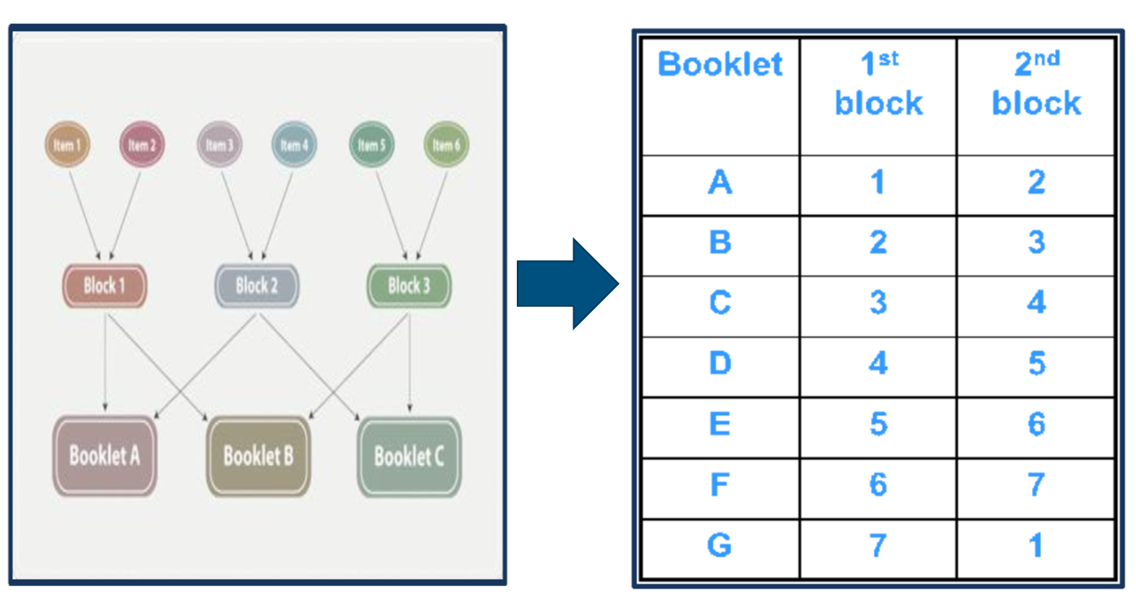
Why use Plausible Values?
Assessment designs!
Test design features
Large scale assessments such as NAEP and TIMSS use a large item pool of test questions to provide comprehensive coverage of each subject domain.
To keep the burden of test-taking low and encourage school participation, each student is administered a small number of items.
But at the assessment level, all items are measured.
Notes:
The reason that large scale assessments such as NAEP and TIMSS uses plausible values is because of their unique test designs.
Unlike other assessments such as state assessments,
Several hundred questions are typically needed to reliably test the many specifications of the complex frameworks that guide NAEP assessments. However, administering the entire collection of cognitive questions to each student would be far too time consuming to be practical. Matrix sampling allows the assessment of an entire subject area within a reasonable amount of testing time, in most cases 50 minutes for paper-pencil administered assessments and 60 minutes for computer administered assessments. By this method, different portions from the entire pool of cognitive questions are printed in separate booklets or assembled separately on the computer and administered to different samples of students.

Slide 5
Advantages and trade-offs of the assessment design
Advantages
Cost efficient and avoids overburdening students and schools
Achieves broad coverage of the targeted content domain
Allows sufficiently precise estimates of proficiency distributions of the target population and sub-populations,
uses IRT and Multiple Imputations to create student scale scores – plausible values.
Trade-offs
Each student receives too few test questions to permit estimating an accurate scale score for that student.
Results in large measurement error and leads to inaccurate inference.

Slide 6
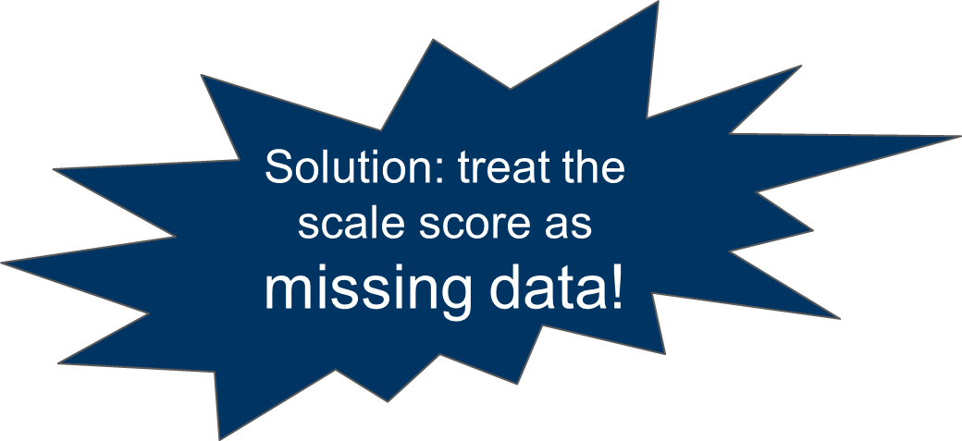
How can an assessment program work without accurate scores for individual students?
One way of taking the uncertainty associated with the estimates into account, and of obtaining unbiased group-level estimates, is to use multiple imputation to impute what we know about the students and obtain the distribution that represent a student’s proficiency.
Plausible values are based on student responses to the subset of items they receive and available background information (Mislevy, 1991).
Notes:
The solution that most large-scale assessments use is multiple imputation. It helps obtain unbiased group-level estimates such as means, regression coefficients, also it can better take the uncertainty, measurement error into account.

Slide 7
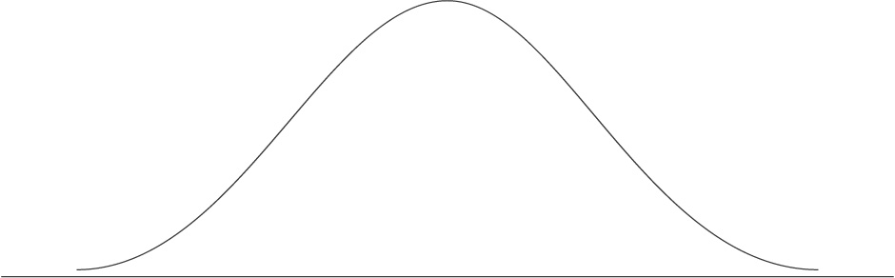
Plausible Values
Ability Distribution
PV2
PV4
PV1
PV5
PV3

Slide 8
How Plausible Values are generated? (von Davier, Gonzalez & Mislevy 2009)
The first stage
requires estimating IRT parameters for each cognitive question.
The second stage
results in latent regressions that imputing scale performance with all information in the student, teacher, and school questionnaires.
The third stage
combines the previous two stages;
draws multiple plausible values from a posterior distribution.
Notes:
Imputation is performed in three stages. The first stage requires estimating IRT parameters for each cognitive question. The second stage results in MML estimation of a set of regression coefficients that capture the relationship between group score distributions and nearly all the information from the variables in the teacher, school, or SD/ELL questionnaires, as well as geographical, sample frame, and school record information. The third stage involves the imputation that is designed to reproduce the group-level results that could be obtained during the second stage.

Slide 9
1st stage: Item response theory (IRT)
Estimating IRT parameters for each cognitive question, and a likelihood function for proficiency.
Common IRT models used in large scale assessments
Dichotomous items: the two- or three-parameter logistics item response model
Polytomous items: the generalized partial credit model

Slide 10

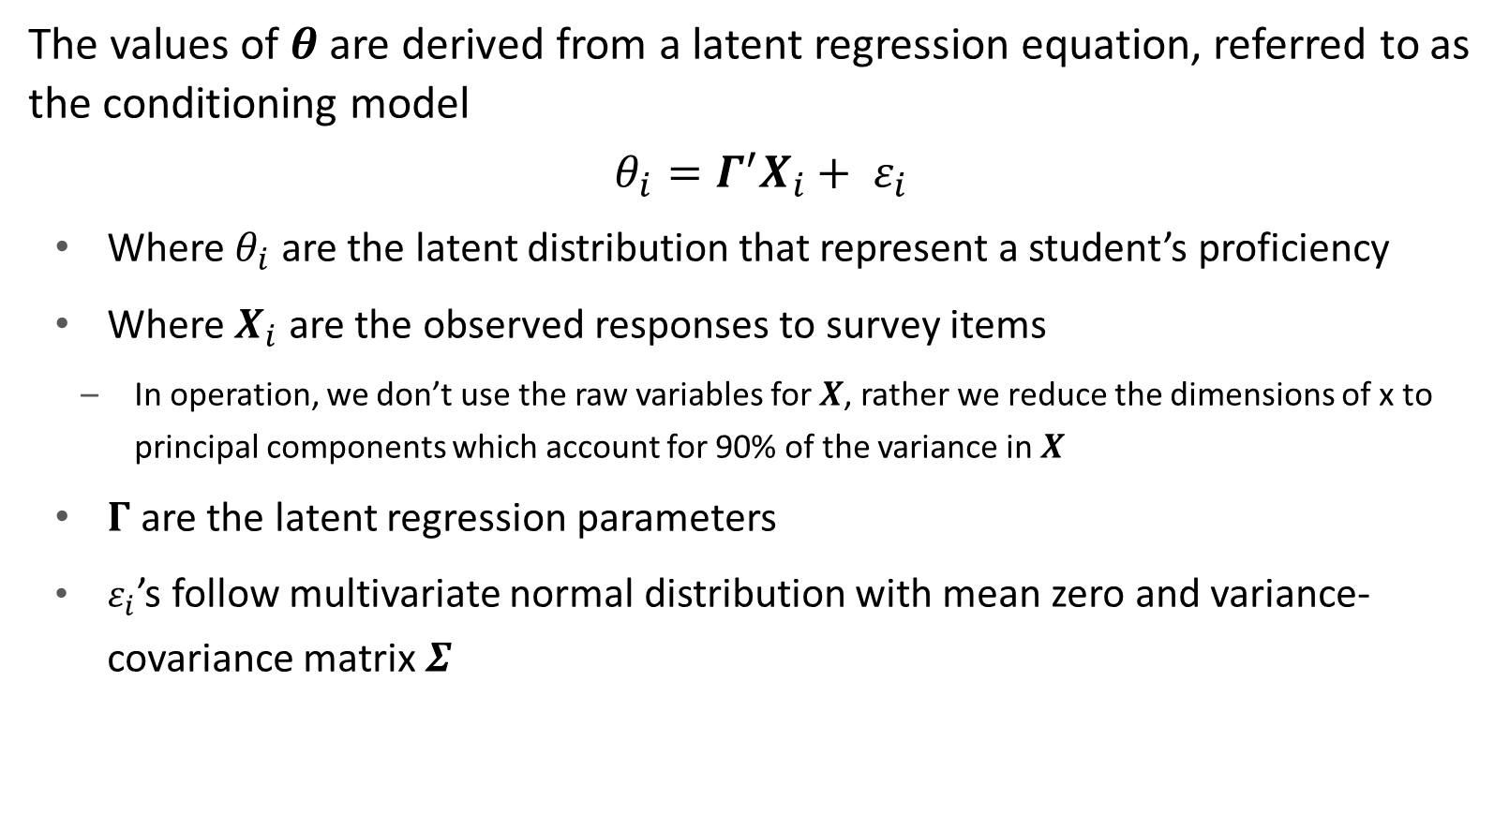
2nd stage: Population model (conditional model)
The values of $θ$ are derived from a latent regression equation, referred to as the conditioning model
${θ_{i}=Γ}^{′}X_{i}+ ε_{i}$
Where $θ_{i}$ are the latent distribution that represent a student’s proficiency
Where $X_{i}$ are the observed responses to survey items
In operation, we don’t use the raw variables for $X$, rather we reduce the dimensions of x to principal components which account for 90% of the variance in $X$
$Γ$are the latent regression parameters
$ε_{i}$’s follow multivariate normal distribution with mean zero and variance-covariance matrix $Σ$

Slide 11
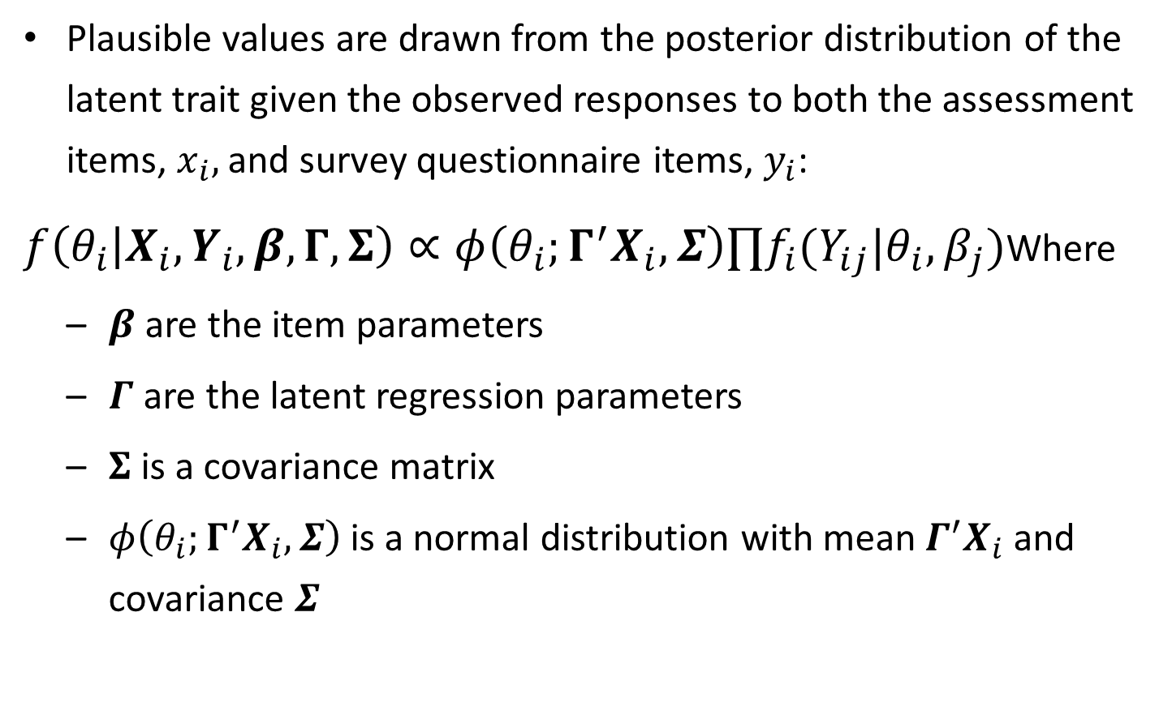
3rd stage: Where Plausible Values come from
Likelihood function based on the item responses
Plausible values are drawn from the posterior distribution of the latent trait given the observed responses to both the assessment items, $x_{i},$ and survey questionnaire items, $y_{i}$:
$f\left(θ_{i} | X_{i},Y_{i},β,Γ,Σ\right)∝φ\left(θ_{i};Γ^{′}X_{i},Σ\right)∏f_{i}(Y_{ij}|θ_{i},β_{j})$Where
$β$are the item parameters
$Γ$ are the latent regression parameters
$Σ$is a covariance matrix
$φ\left(θ_{i};Γ^{′}X_{i},Σ\right)$is a normal distribution with mean $Γ^{′}X_{i}$ and covariance $Σ$
Latent regression

Slide 12
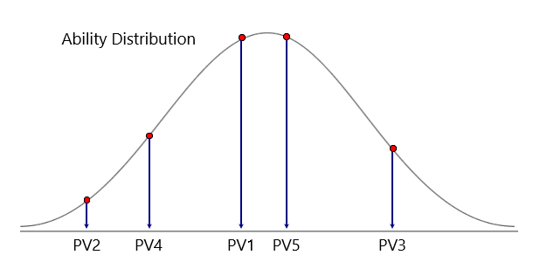
What are Plausible Values?
Instead of individual student scores, we draw multiple potential values from the posterior distribution of the latent trait given the observed responses to both the assessment items and survey questionnaire.
TIMSS: 5 PVs
NAEP: 20 PVs starting 2013; 5 PVs prior to 2013
Plausible values enable the variance estimates to include measurement error – due to the limited number of items for each student

Slide 13
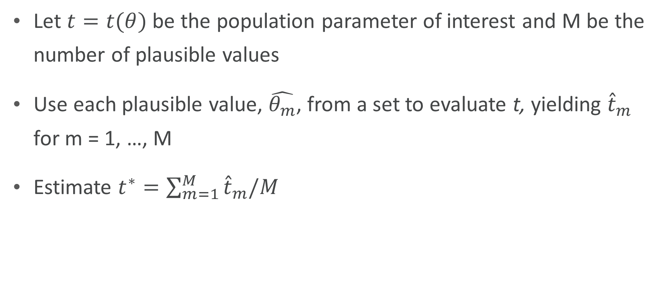
How do we analyze Plausible Values?
Let $t=t(θ)$ be the population parameter of interest and M be the number of plausible values
Use each plausible value, $\hat{θ_{m}}$, from a set to evaluate t, yielding ${\hat{t}}_{m}$ for m = 1, …, M
Estimate $t^{∗}=\sum_{m=1}^{M}{{\hat{t}}_{m}/M}$

Slide 14
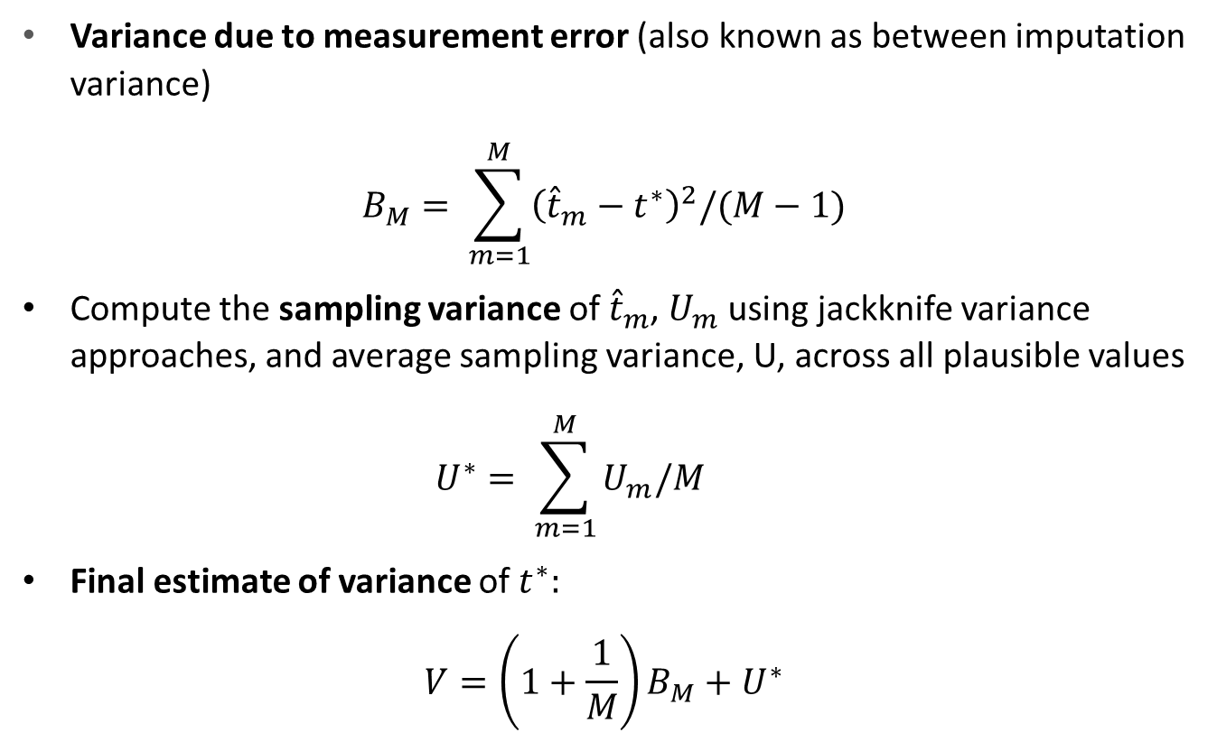
Variance estimation from Plausible Values
Variance due to measurement error (also known as between imputation variance)
$$B_{M}= \sum_{m=1}^{M}{{\left({\hat{t}}_{m}−t^{∗}\right)}^{2}/(M}−1)$$
Compute the sampling variance of ${\hat{t}}_{m}$, $U_{m}$ using jackknife variance approaches, and average sampling variance, U, across all plausible values
$$U^{∗}= \sum_{m=1}^{M}{U_{m}/M}$$
Final estimate of variance of $t^{∗}:$
$$V=\left(1+\frac{1}{M}\right)B_{M}+U^{∗}$$
measurement variance + sampling variance

Slide 15

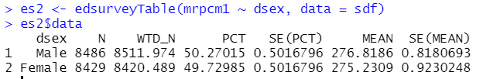
Examples using NAEP Primer data
All plausible values were used
Only one plausible value was used

Slide 16
Poll
Why is the SE from the 2nd example SMALLER than the SE from the 1st example?
The weights were not applied
The outcome variables are different
The measurement variance is missing
The sampling variance is missing

Slide 17
Takeaways
When conducting a NAEP analysis that involves plausible values. Always
Use the full set of the PVs
Apply the appropriate sampling weight(s)
Calculate correct variance estimation, which usually has two components
Measurement/imputation variance
Sampling variance

Slide 18
Tools analyzing data with Plausible Values
EdSurvey package in R is designed to analyze NCES data with plausible values and complex sampling design.
Dire package in R analyze NAEP and TIMSS data and conduct direct estimation for students’ scale scores.
Standard statistical software packages can also be used, such as SAS, Stata, or SPSS
For simple analyses (e.g. comparing group means, simple correlations, summary tables), check out the NAEP Data Explorer and International Data Explorer.

Slide 19
Homework
Download and install R and R studio
Download TIMSS data 2019-2011 using EdSurvey function “downloadTIMSS”
install.packages("EdSurvey")
library(EdSurvey)
downloadTIMSS(years = c(2019, 2015, 2011), root = "C:/")

Slide 20
Reference
Mislevy, R. (1991). Randomization-based inference about latent variables from complex samples. Psychometrika, 56, 177–196.
Rubin, D. (1987). Multiple imputation for nonresponse in sample surveys. New York: John Wiley.
Rutkowski, L., Gonzalez, E., Joncas, M., & von Davier, M. (2010). International large-scale assessment data: Issues in secondary analysis and reporting. Educational Researcher, 39(2), 142-151.
von Davier, M., Gonzalez, E., & Mislevy, R. (2009). Plausible values: What are they and why do we need them? IERI Monograph Series: Issues and Methodologies in Large-Scale Assessments, 2, 9–36.
von Davier, M., & Sinharay, S. (2014). Analytics in international large-scale assessments: Item response theory and population models. In L. Rutkowski, M. von Davier, & D. Rutkowski (Eds.), Handbook of international large-scale assessment (pp. 155–174). Boca Raton, FL: Taylor & Francis.

Slide 21
Ting Zhang
Senior Psychometrician / Statistician
202.403.6646
tzhang@air.org

